Slide 1
Probabilistic Machine Learning Some Basics of Probability
CSN-382

Slide 2
Some Probability Basics

Slide 3
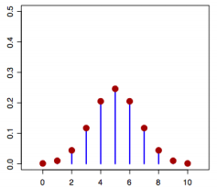
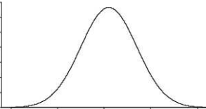

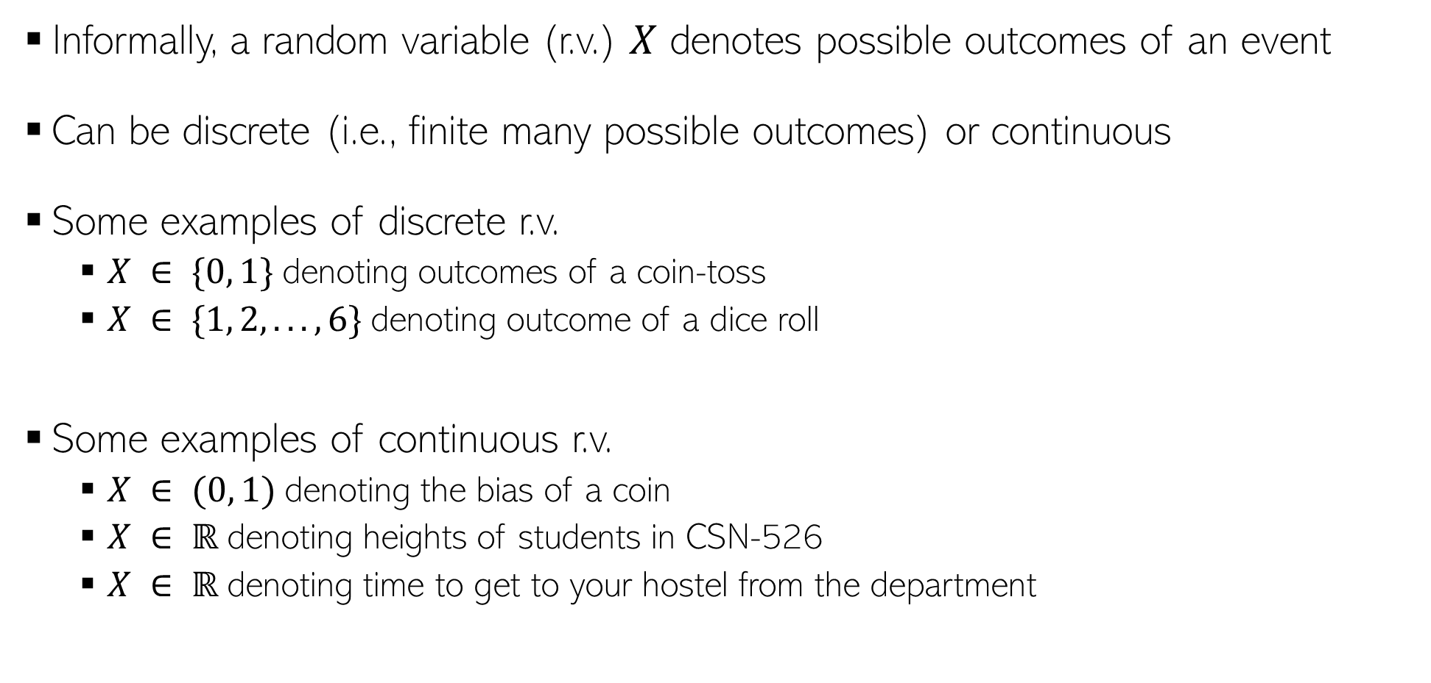



Random Variables
Informally, a random variable (r.v.) $X$ denotes possible outcomes of an event
Can be discrete (i.e., finite many possible outcomes) or continuous
Some examples of discrete r.v.
$X ∈ \{0, 1\}$denoting outcomes of a coin-toss
$X ∈ \{1, 2, . . . , 6\}$denoting outcome of a dice roll
Some examples of continuous r.v.
$X ∈ (0, 1)$denoting the bias of a coin
$X ∈ ℝ$denoting heights of students in CSN-526
$X ∈ ℝ$denoting time to get to your hostel from the department
$$p(X)$$
$X$(a discrete r.v.)
$$p(X)$$
$X$(a continuous r.v.)

Slide 4
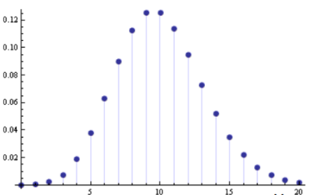




Discrete Random Variables
For a discrete r.v. $X$, $p(x)$ denotes $p(X = x)$ - probability that $X = x$
$p(X)$ is called the probability mass function (PMF) of r.v. $X$
$p(x)$ or $p(X = x)$ is the value of the PMF at $x$
$$p\left(x\right)≥0$$
$$p\left(x\right)≤ 1$$
$$\sum_{x}{p\left(x\right)=1}$$
$$p(X)$$
$$X$$

Slide 5
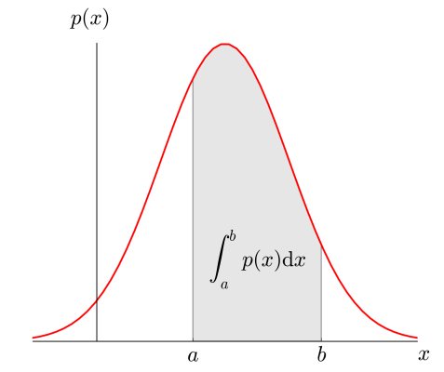




Continuous Random Variables
For a continuous r.v. $X$, a probability $p(X = x)$ or $p(x)$ is meaningless
For cont. r.v., we talk in terms of prob. within an interval $X ∈(x,x+δx)$
$p(x)δx$ is the prob. that $X ∈(x,x+δx)$as $δx→0$
$p(x)$ is the probability density at $X= x$
Yes, probability density at a point $x$ can very well be larger than 1. The integral however must be equal to 1
$$p\left(x\right)≥0$$
$$p\left(x\right)≤ 1$$
$$\int{p\left(x\right)dx=1}$$
Notes:
Probability will always be <= 1, but probability density can be > 1.
The probability density in case of continuous random variable is derivative of CDF of random variable.
The definition of P(X=x) is not P(X=x)=f(x) but more P(X=x)=P(X≤x)−P(X<x)=F(x)−F(x−).
In a discrete random variable, F(x−)≠F(x) so P(X=x)>0.
However, in the case of a continuous random variable, F(x−)=F(x) (by the definition of continuity) so P(X=x)=0. This can be seen as the probability of choosing 1/2 while choosing a number between 0 and 1 is zero.
In summary, for continuous random variables P(X=x)≠f(x).
If we consider the probability density function for the Normal distribution with mean 0 and variance 0.1, at x=0 the density has value which is nearly 3.9.
Clearly, densities can have values greater than 1. This is possible because the value of the density isn’t a probability. Instead, probability is represented by the area beneath the density.

Slide 6
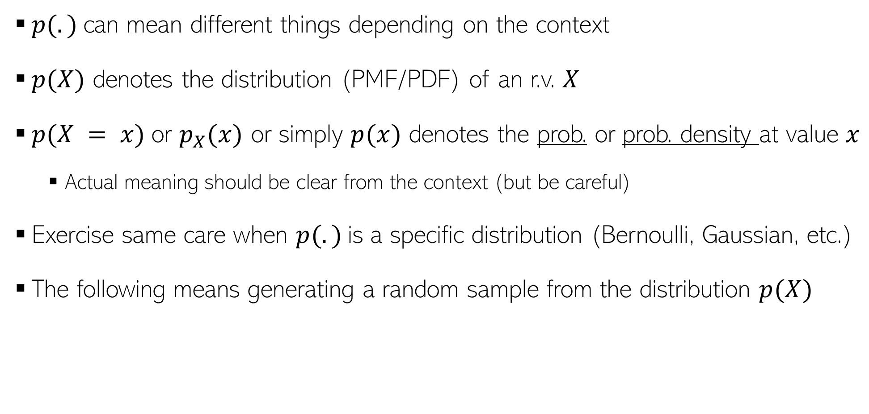
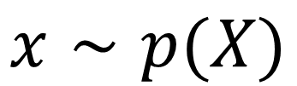
A word about notation
$p(.)$can mean different things depending on the context
$p(X)$ denotes the distribution (PMF/PDF) of an r.v. $X$
$p(X = x)$or $p_{X}(x)$ or simply $p(x)$ denotes the prob. or prob. density at value $x$
Actual meaning should be clear from the context (but be careful)
Exercise same care when $p(.)$is a specific distribution (Bernoulli, Gaussian, etc.)
The following means generating a random sample from the distribution $p(X)$
$$x∼p(X)$$

Slide 7
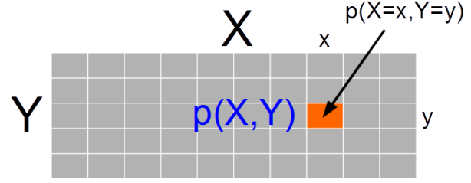
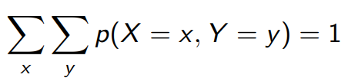
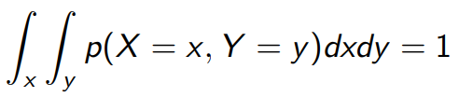

Joint Probability Distribution
Joint prob. dist. $p(X, Y)$ models probability of co-occurrence of two r.v. $X, Y$
For discrete r.v., the joint PMF $p(X, Y )$is like a table (that sums to 1)
For two continuous r.v.’s $X$ and $Y$, we have joint PDF $p(X, Y)$
For 3 r.v.’s, we will likewise have a “cube” for the PMF. For more than 3 r.v.’s too, similar analogy holds
For more than two r.v.’s, we will likewise have a multi-dim integral for this property

Slide 8
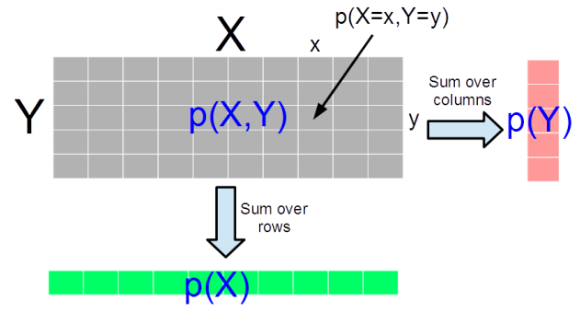

Marginal Probability Distribution
Consider two r.v.’s X and Y (discrete/continuous – both need not of same type)
Marg. Prob. is PMF/PDF of one r.v. accounting for all possibilities of the other r.v.
For discrete r.v.’s, $p\left(X\right)= \sum_{y}{p(X,Y=y)}$ and $p\left(Y\right)=\sum_{x}{p(X=x,Y)}$
For discrete r.v. it is the sum of the PMF table along the rows/columns
For continuous r.v.’s,
The definition also applied for two sets of r.v.’s and marginal of one set of r.v.’s is obtained by summing over all possibilities of the second set of r.v.’s
For discrete r.v.’s, marginalization is called summing over, for continuous r.v.’s, it is called “integrating out”

Slide 9
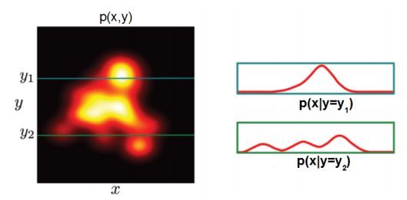
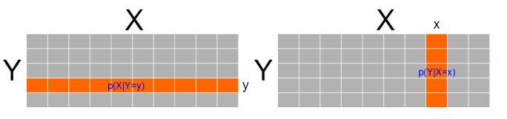
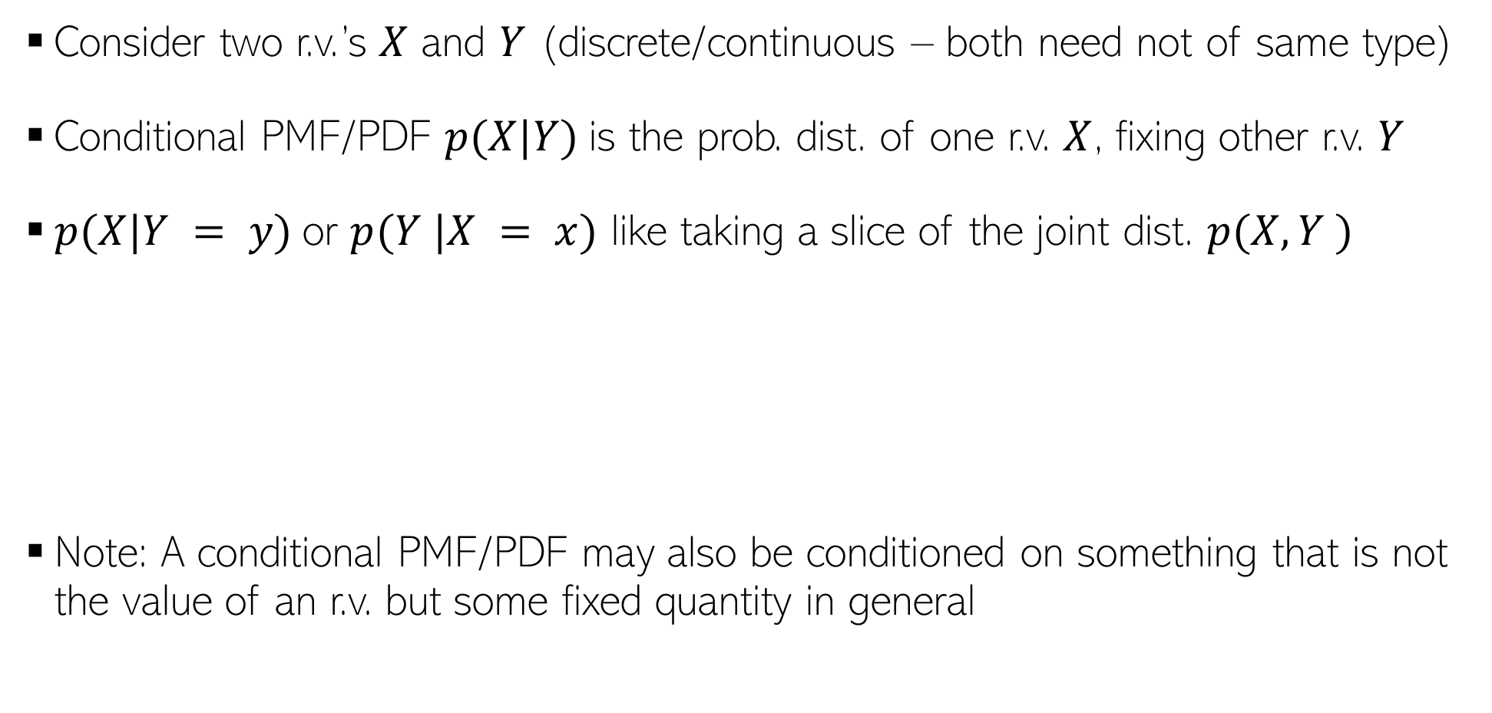
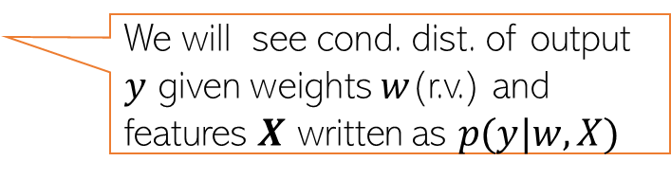
Conditional Probability Distribution
Consider two r.v.’s $X$ and $Y$ (discrete/continuous – both need not of same type)
Conditional PMF/PDF $p(X|Y)$is the prob. dist. of one r.v. $X$, fixing other r.v. $Y$
$p(X|Y = y)$or $p(Y |X = x)$ like taking a slice of the joint dist. $p(X, Y )$
Note: A conditional PMF/PDF may also be conditioned on something that is not the value of an r.v. but some fixed quantity in general
Continuous Random Variables
Discrete Random Variables
We will see cond. dist. of output $y$ given weights $w$(r.v.) and features $X$ written as $p(y|w,X)$

Slide 10
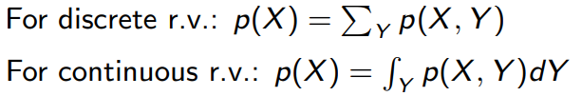
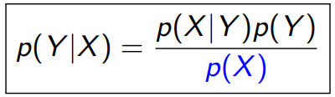
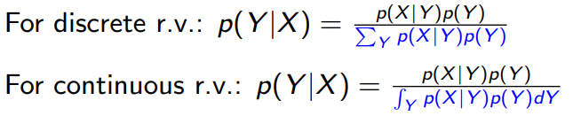
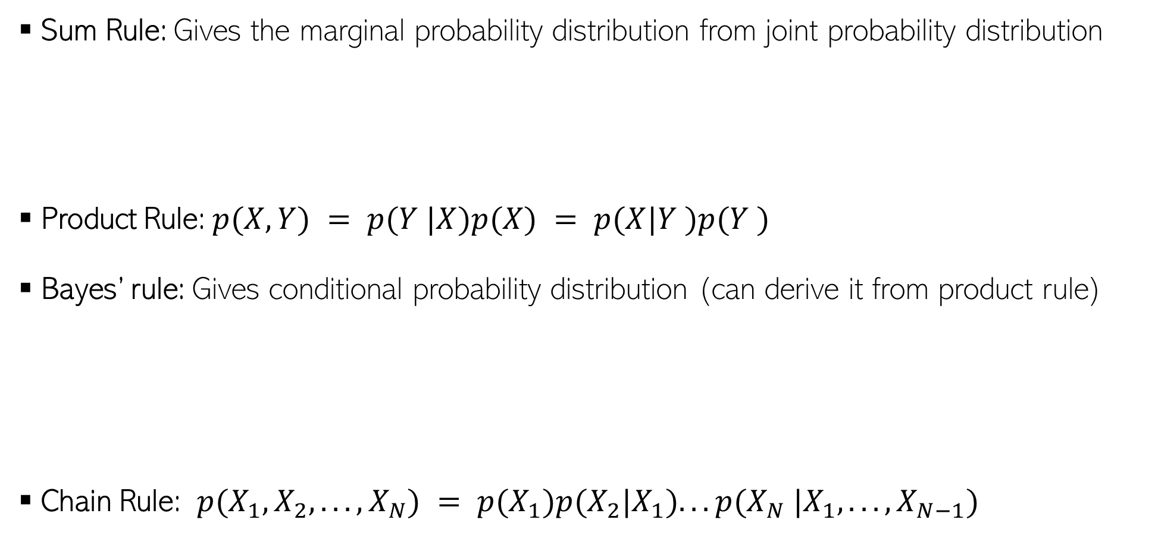
Some Basic Rules
Sum Rule: Gives the marginal probability distribution from joint probability distribution
Product Rule: $p(X, Y) = p(Y |X)p(X) = p(X|Y )p(Y )$
Bayes’ rule: Gives conditional probability distribution (can derive it from product rule)
Chain Rule: $p(X_{1}, X_{2}, . . . , X_{N}) = p(X_{1})p(X_{2}|X_{1}). . . p(X_{N} |X_{1}, . . . , X_{N−1})$

Slide 11

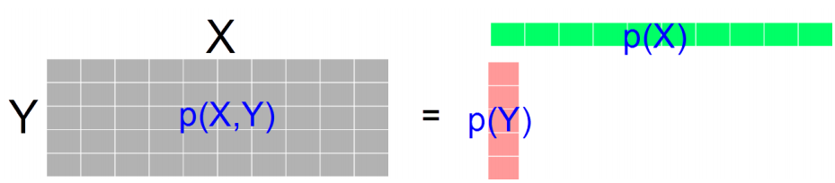


Independence
$X$ and $Y$ are independent when knowing one tells nothing about the other
The above is the marginal independence $(X ⫫ Y)$
Two r.v.’s $X$ and $Y$ may not be marginally indep but may be given the value of another r.v. $Z$
Notes:
Independence doesn’t imply conditional independence, and conditional independence doesn’t imply independence.

Slide 12
Coming up next
Some other basic concepts from probability and statistics
Probabilistic models and parameter estimation in probabilistic models
MLE, MAP, Bayesian approaches

